Slide 1
INCLUSIVE EXCELLENCE IN TEACHING
MAY 14TH, 2012
DIVERITY COUNCIL SUMMER WORKSHOP
SPONSORED BY THE STETSON UNIVERSITY DIVERSITY COUNCIL, THE PRESIDENT’S OFFICE, AND THE OFFICE OF ACADEMIC AFFAIRS

Slide 2
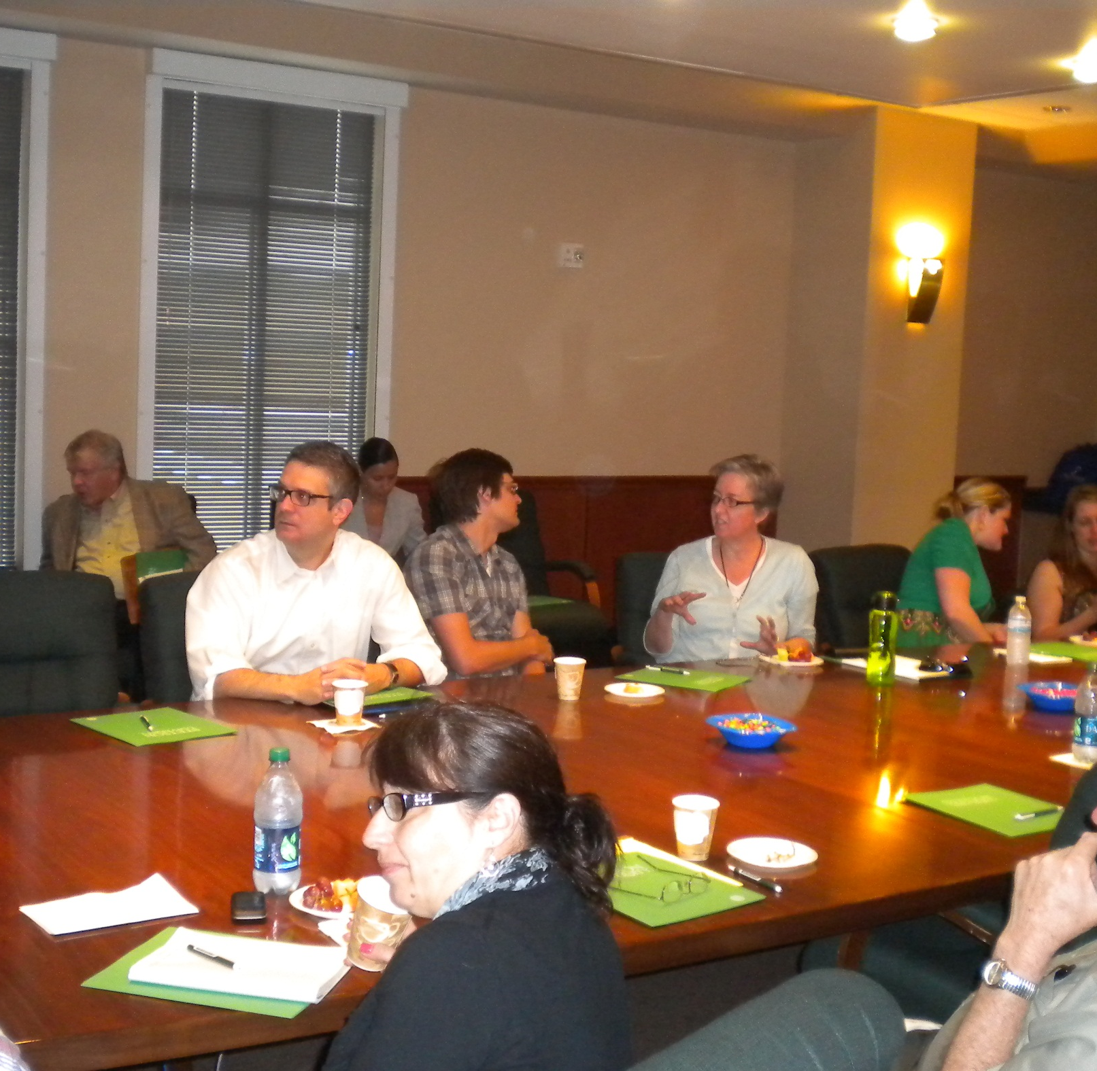
SOCIALIZING BEFORE PROGAM BEGINS

Slide 3
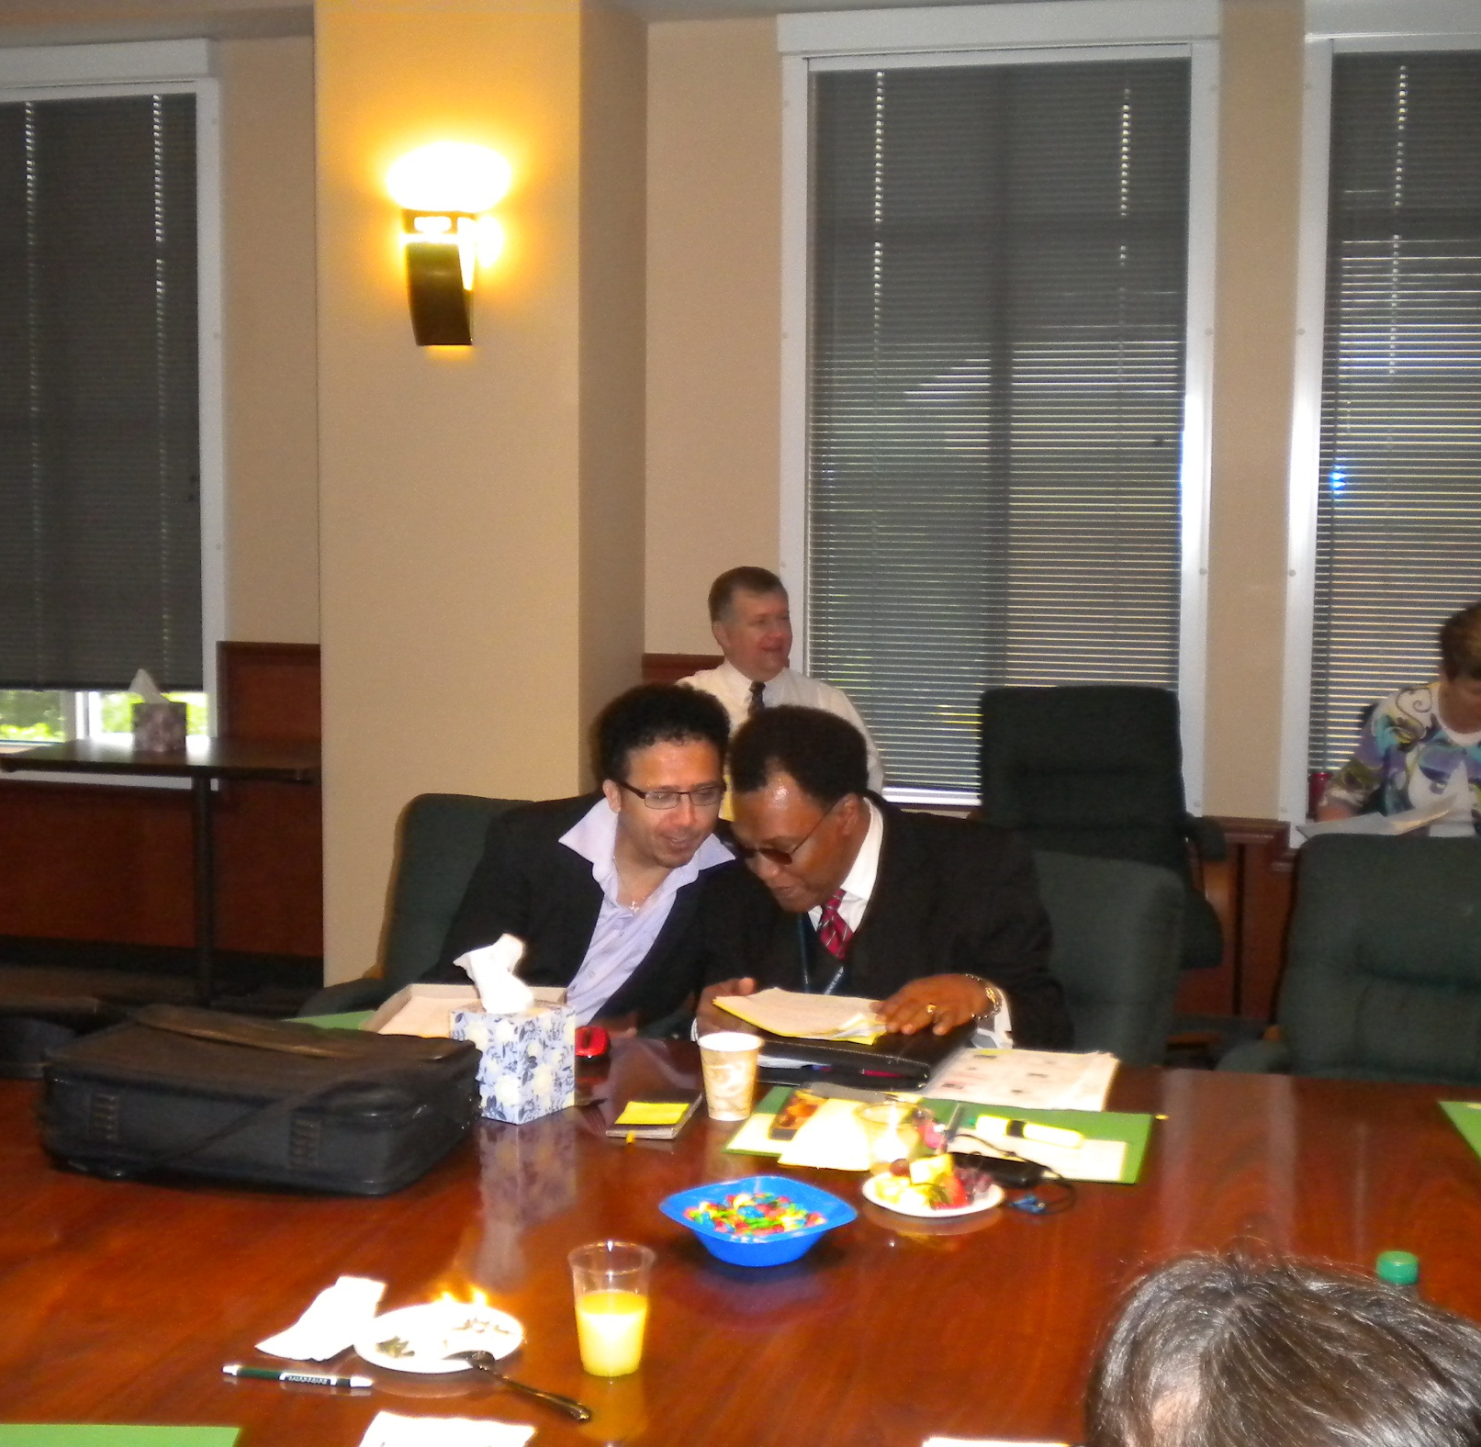
COMPARING NOTES

Slide 4
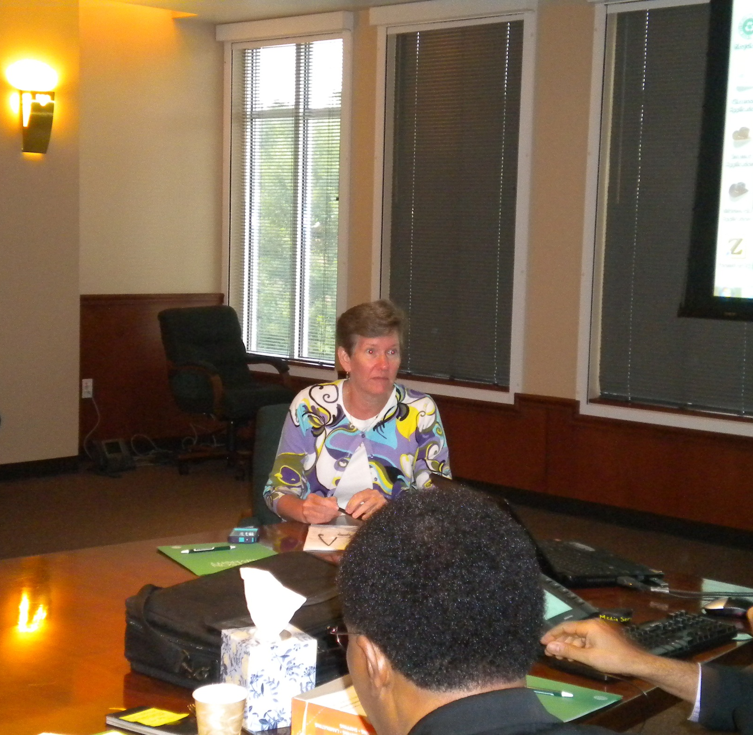
PROVOST BETH PAUL
A FORMAL WELCOME

Slide 5
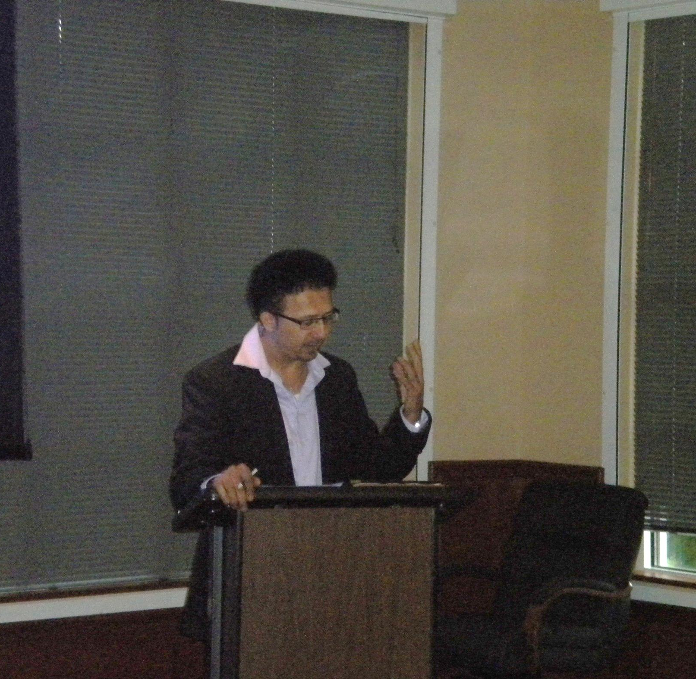
Jamil khader
WELCOMING REMARKS

Slide 6
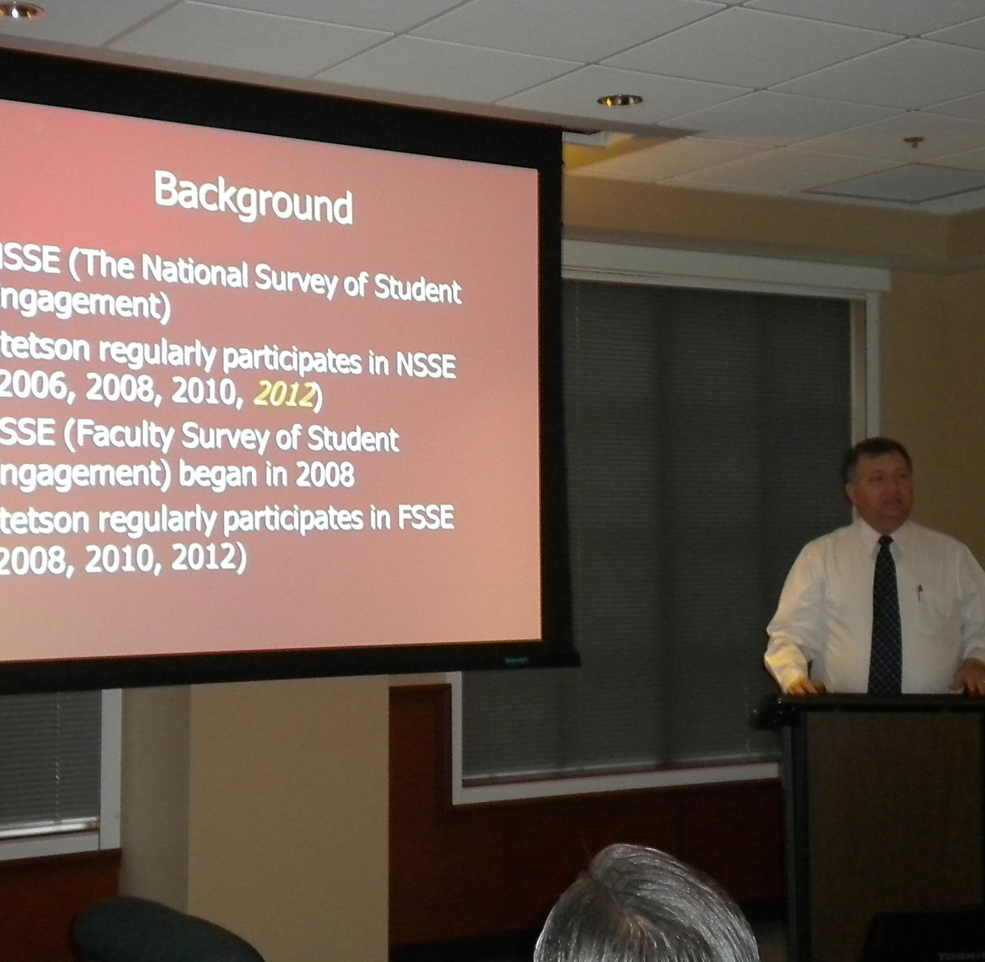
John tichenor
Diversity at Stetson: The Perspectives of Students and Faculty

Slide 7
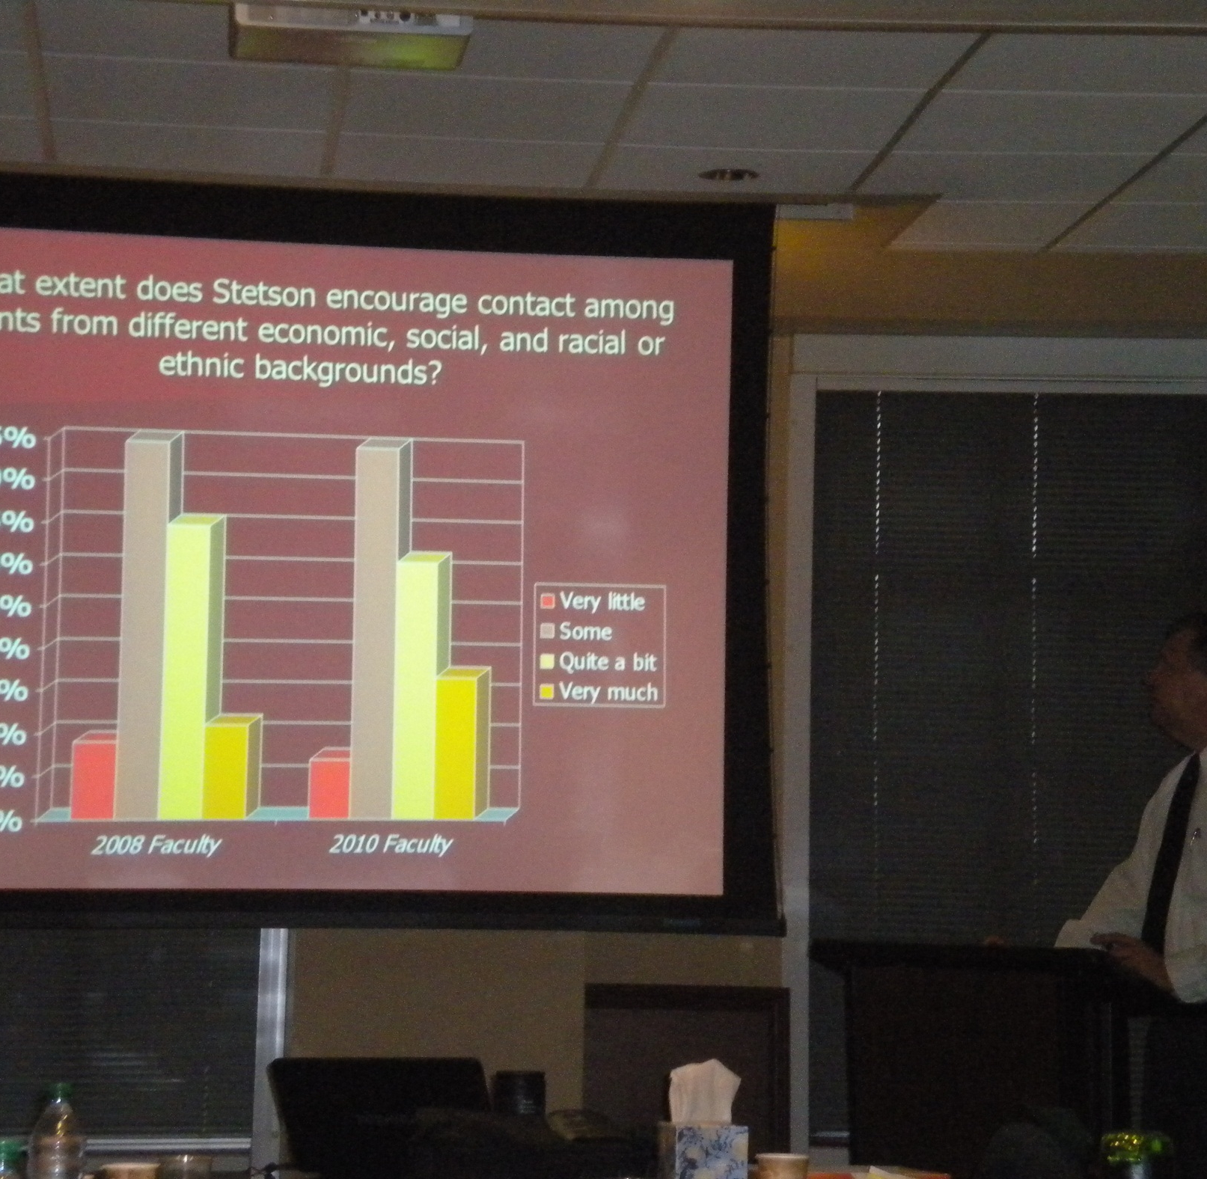
John tichenor
Diversity at Stetson: The Perspectives of Students and Faculty

Slide 8
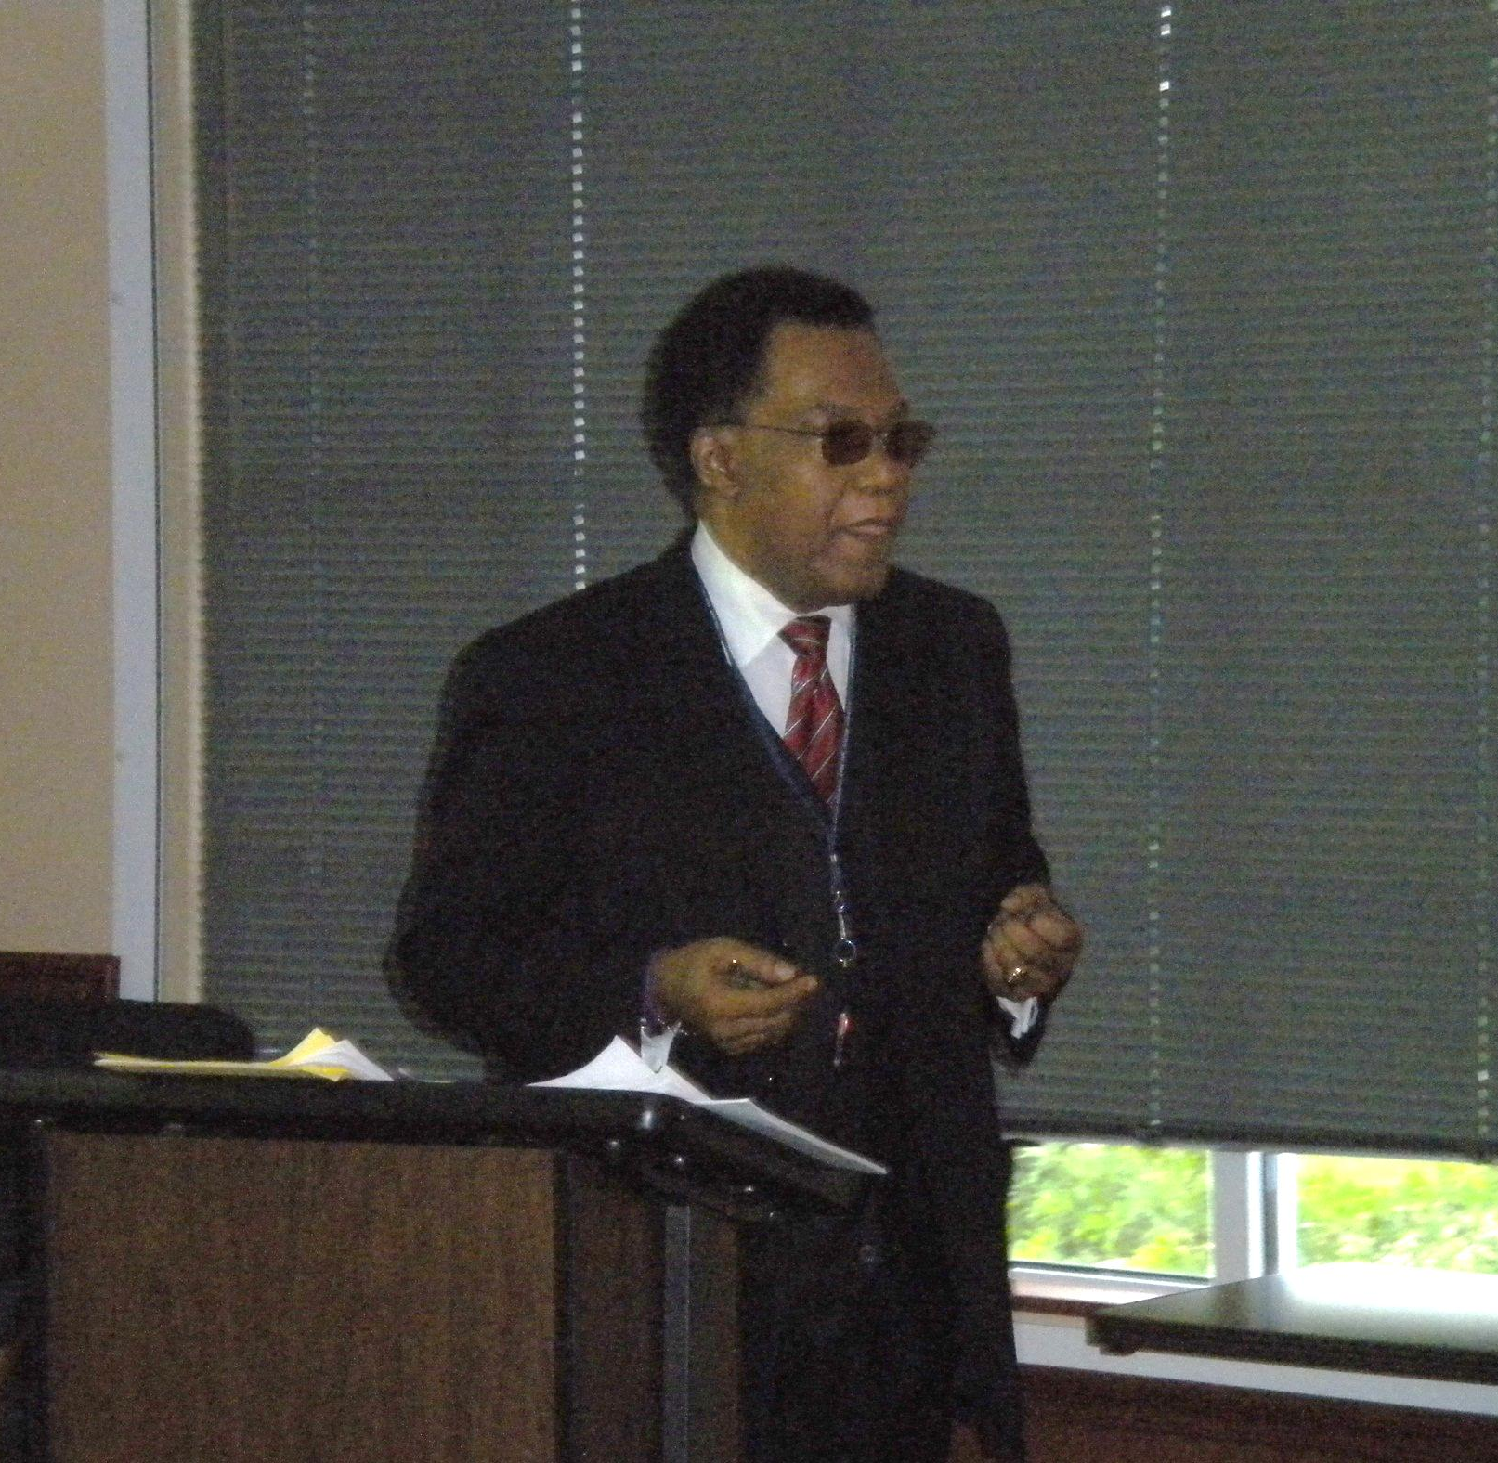
Patrick coggins
Making a Difference: Culturally Responsive Teaching (CRT)

Slide 9
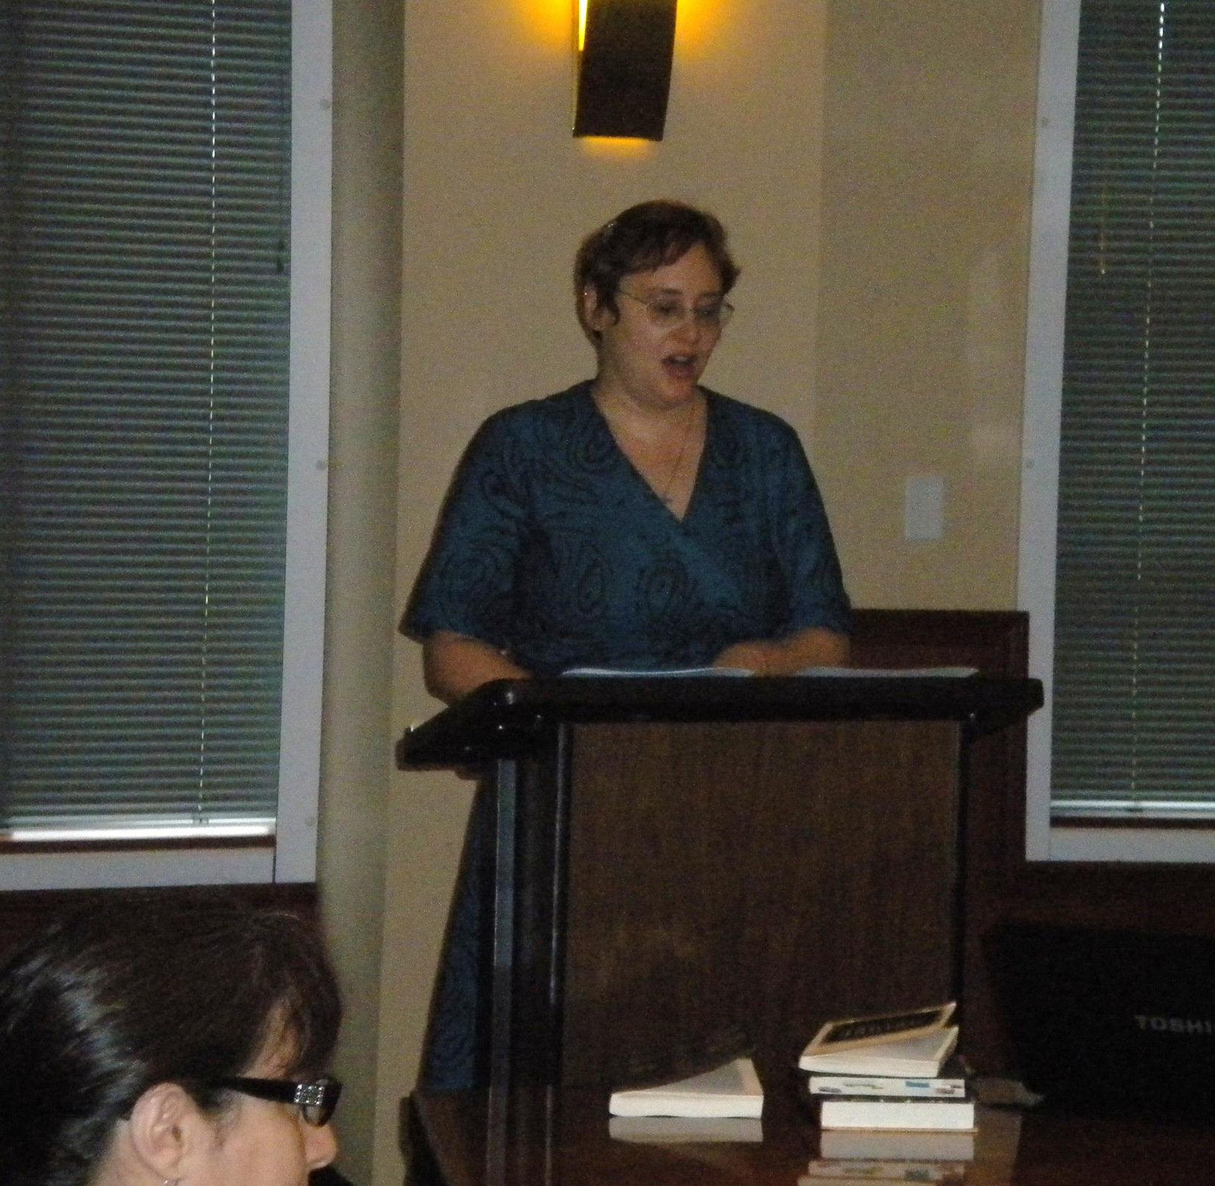
Susan peppers bates
Strategies for Re-Visioning the Canon
in the Philosophy Classroom

Slide 10
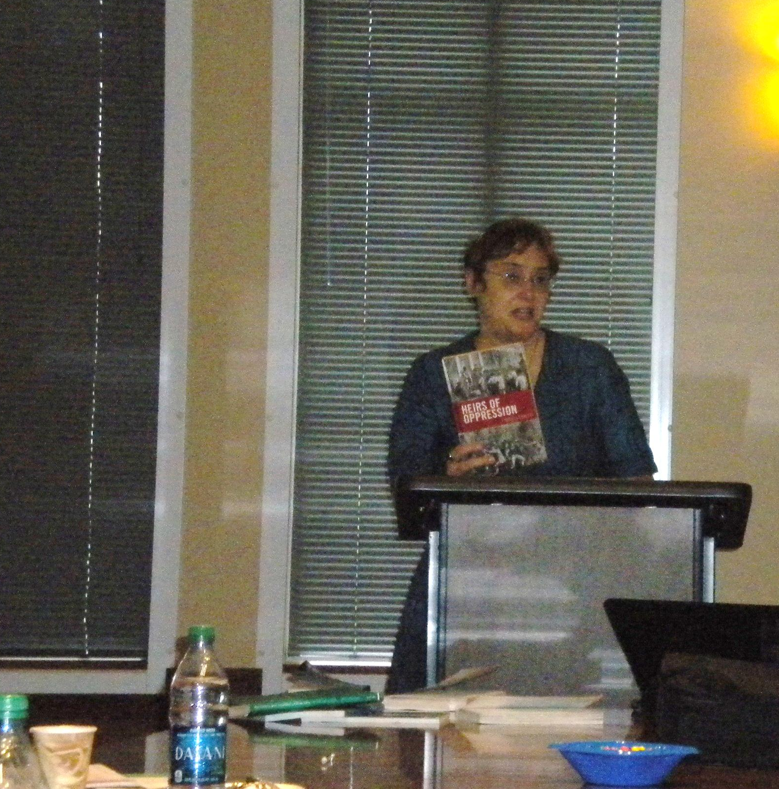
Susan peppers bates
Strategies for Re-Visioning the Canon
in the Philosophy Classroom

Slide 11
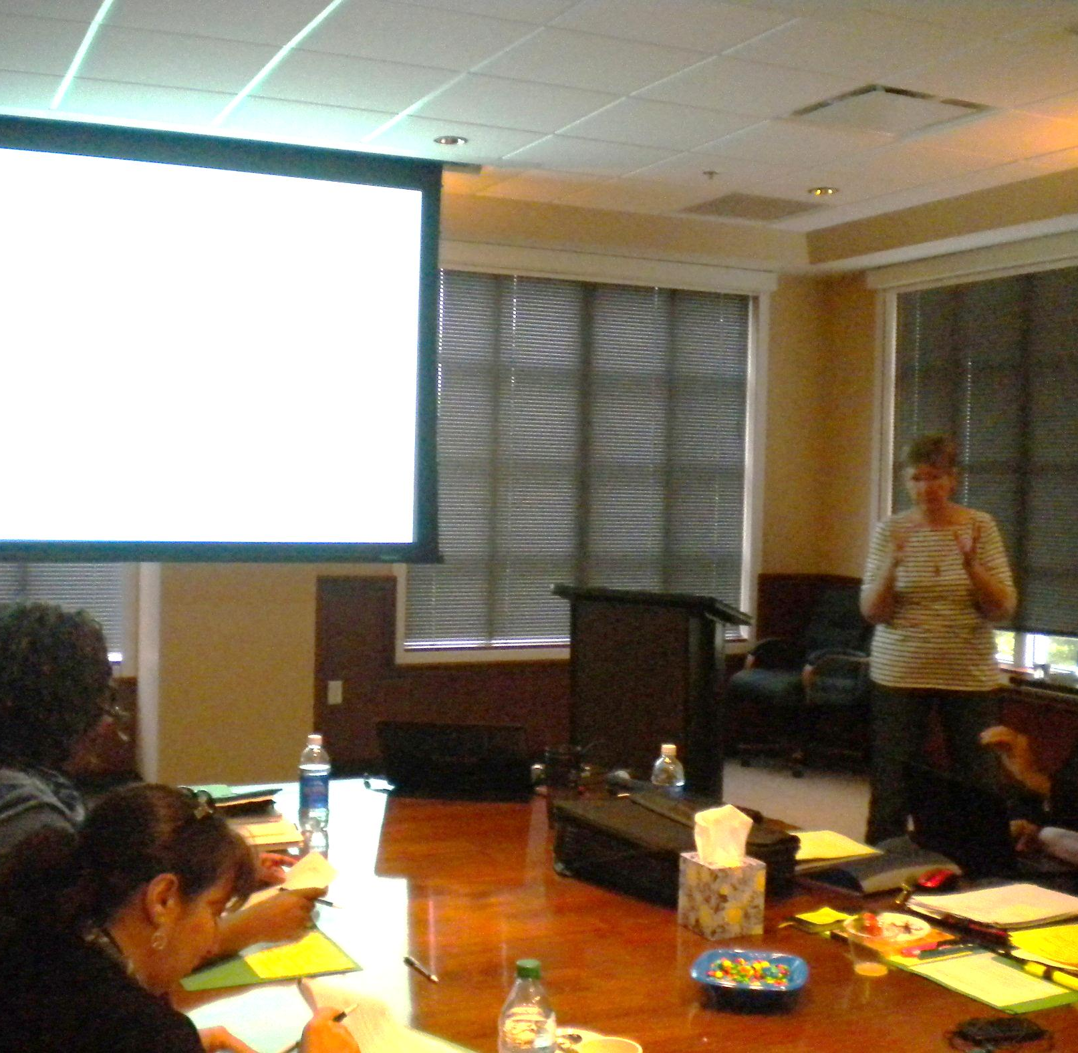
Elisabeth poeter
Border Crossings: Teaching Inclusiveness in German Culture and Film Courses

Slide 12
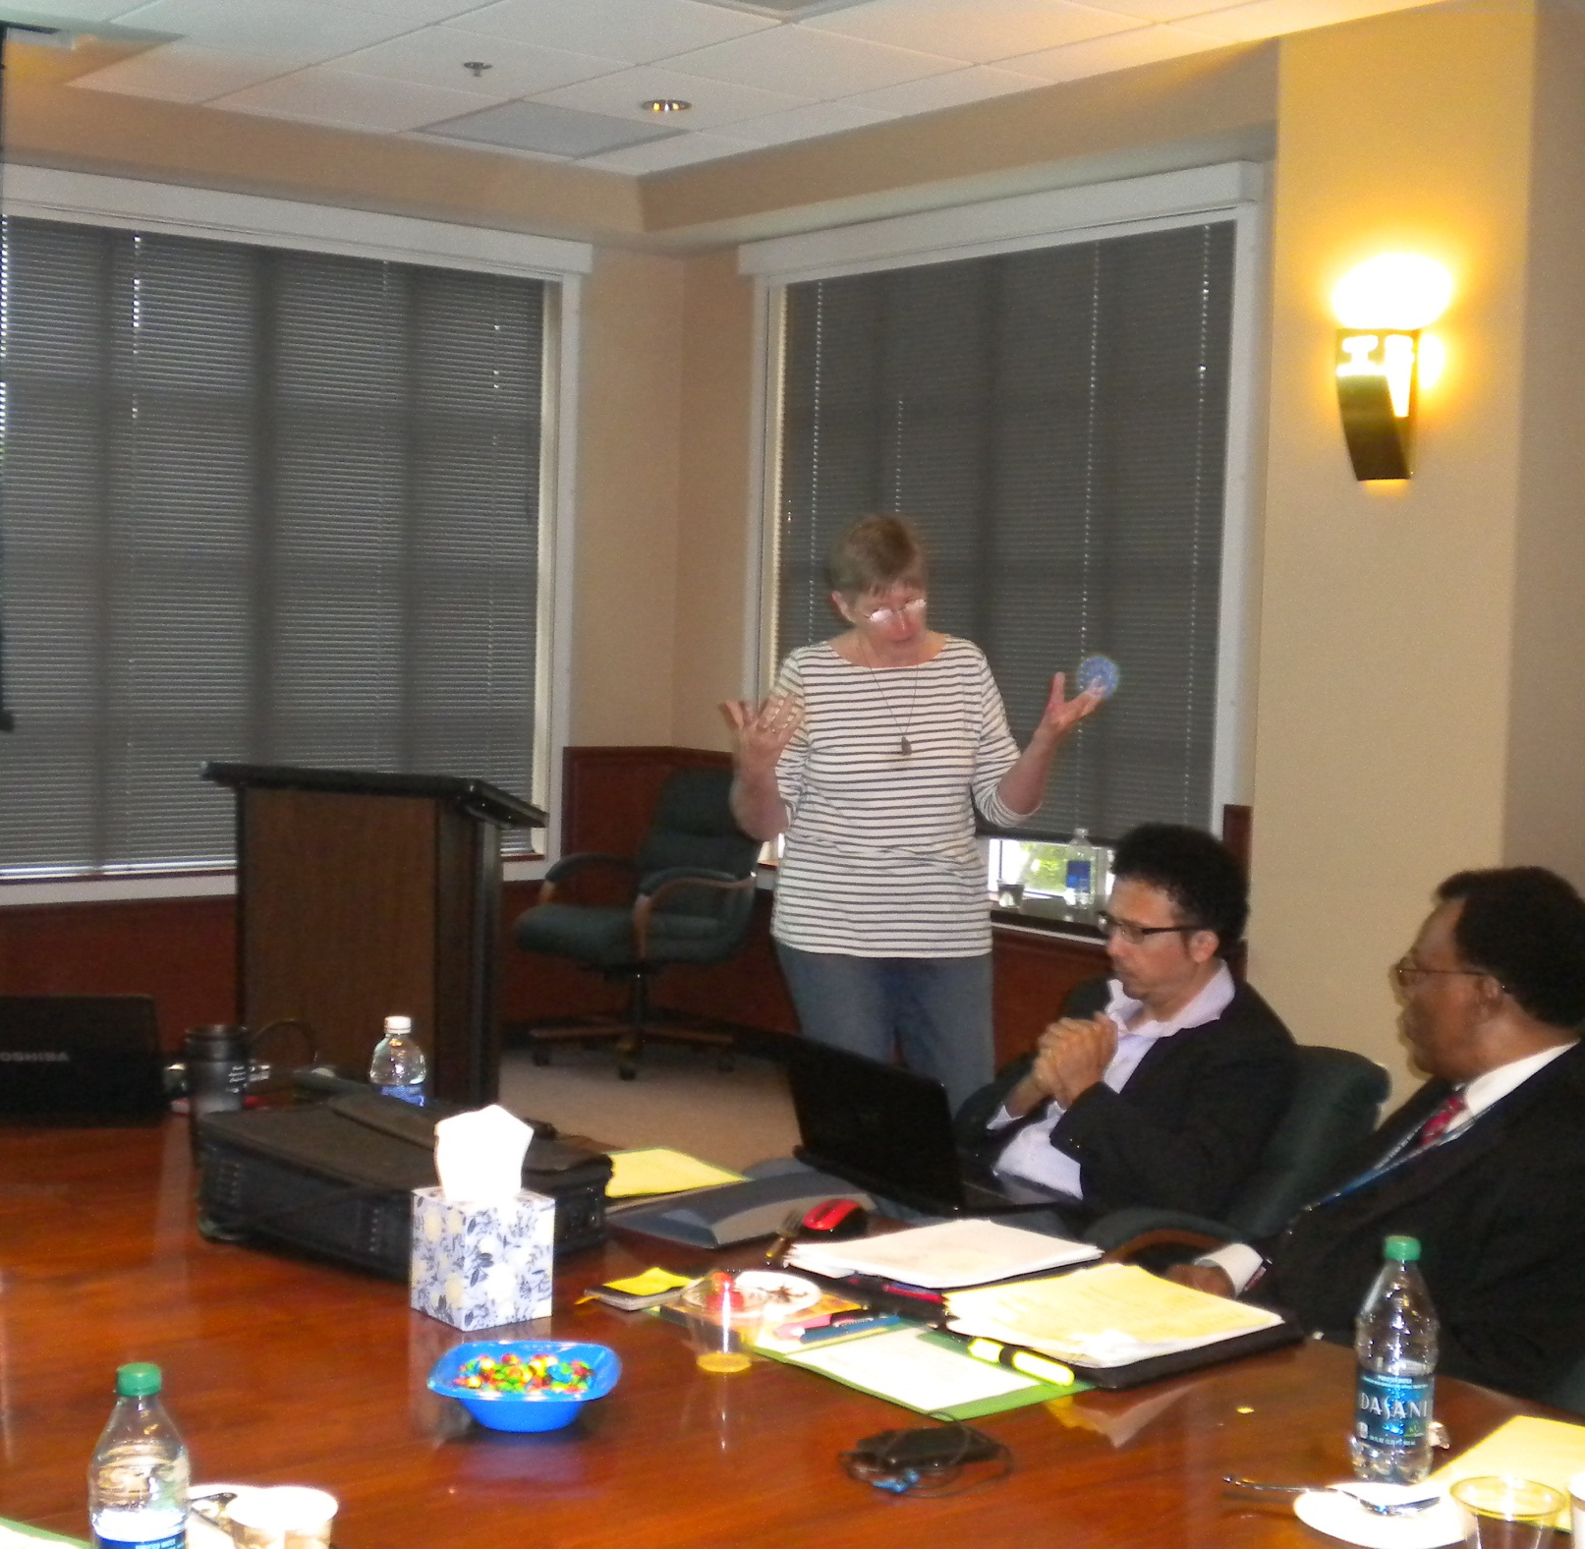
Elisabeth poeter
Border Crossings: Teaching Inclusiveness in German Culture and Film Courses

Slide 13
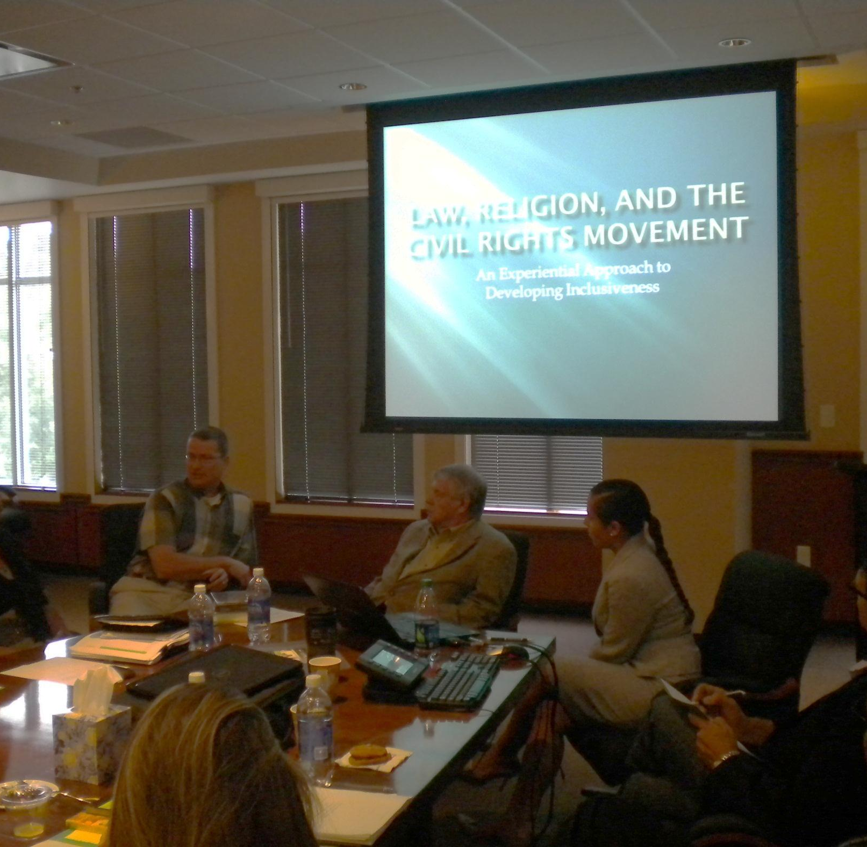
GREG SAPP,
ROBERT BICKEL, and
TAMMY BRIANT
Law, Religion, and the Civil Rights Movement:
An Experiential Approach to Developing Inclusiveness

Slide 14
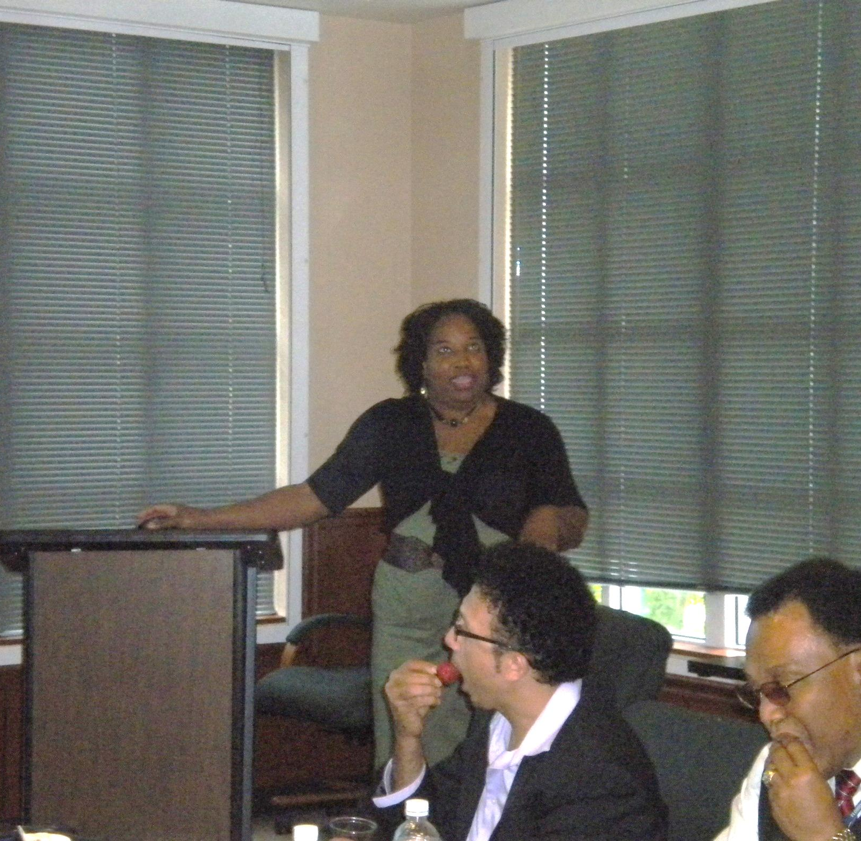
SHAWNRECE CAMPBELL
Stetson University Interactive Diversity Workshop

Slide 15
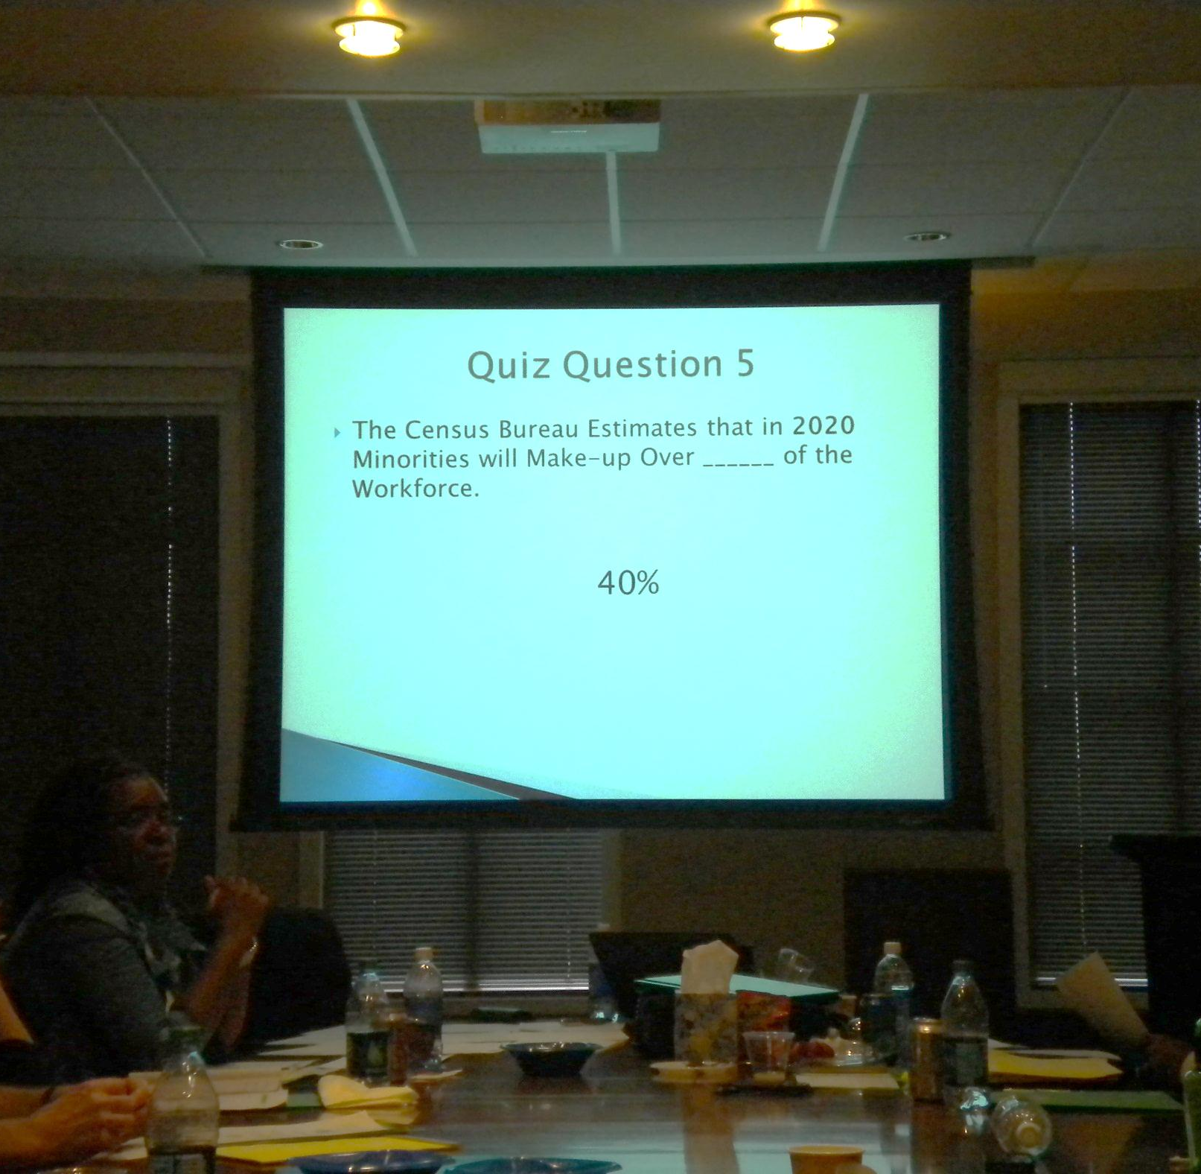
SHAWNRECE CAMPBELL
Stetson University Interactive Diversity Workshop

Slide 16
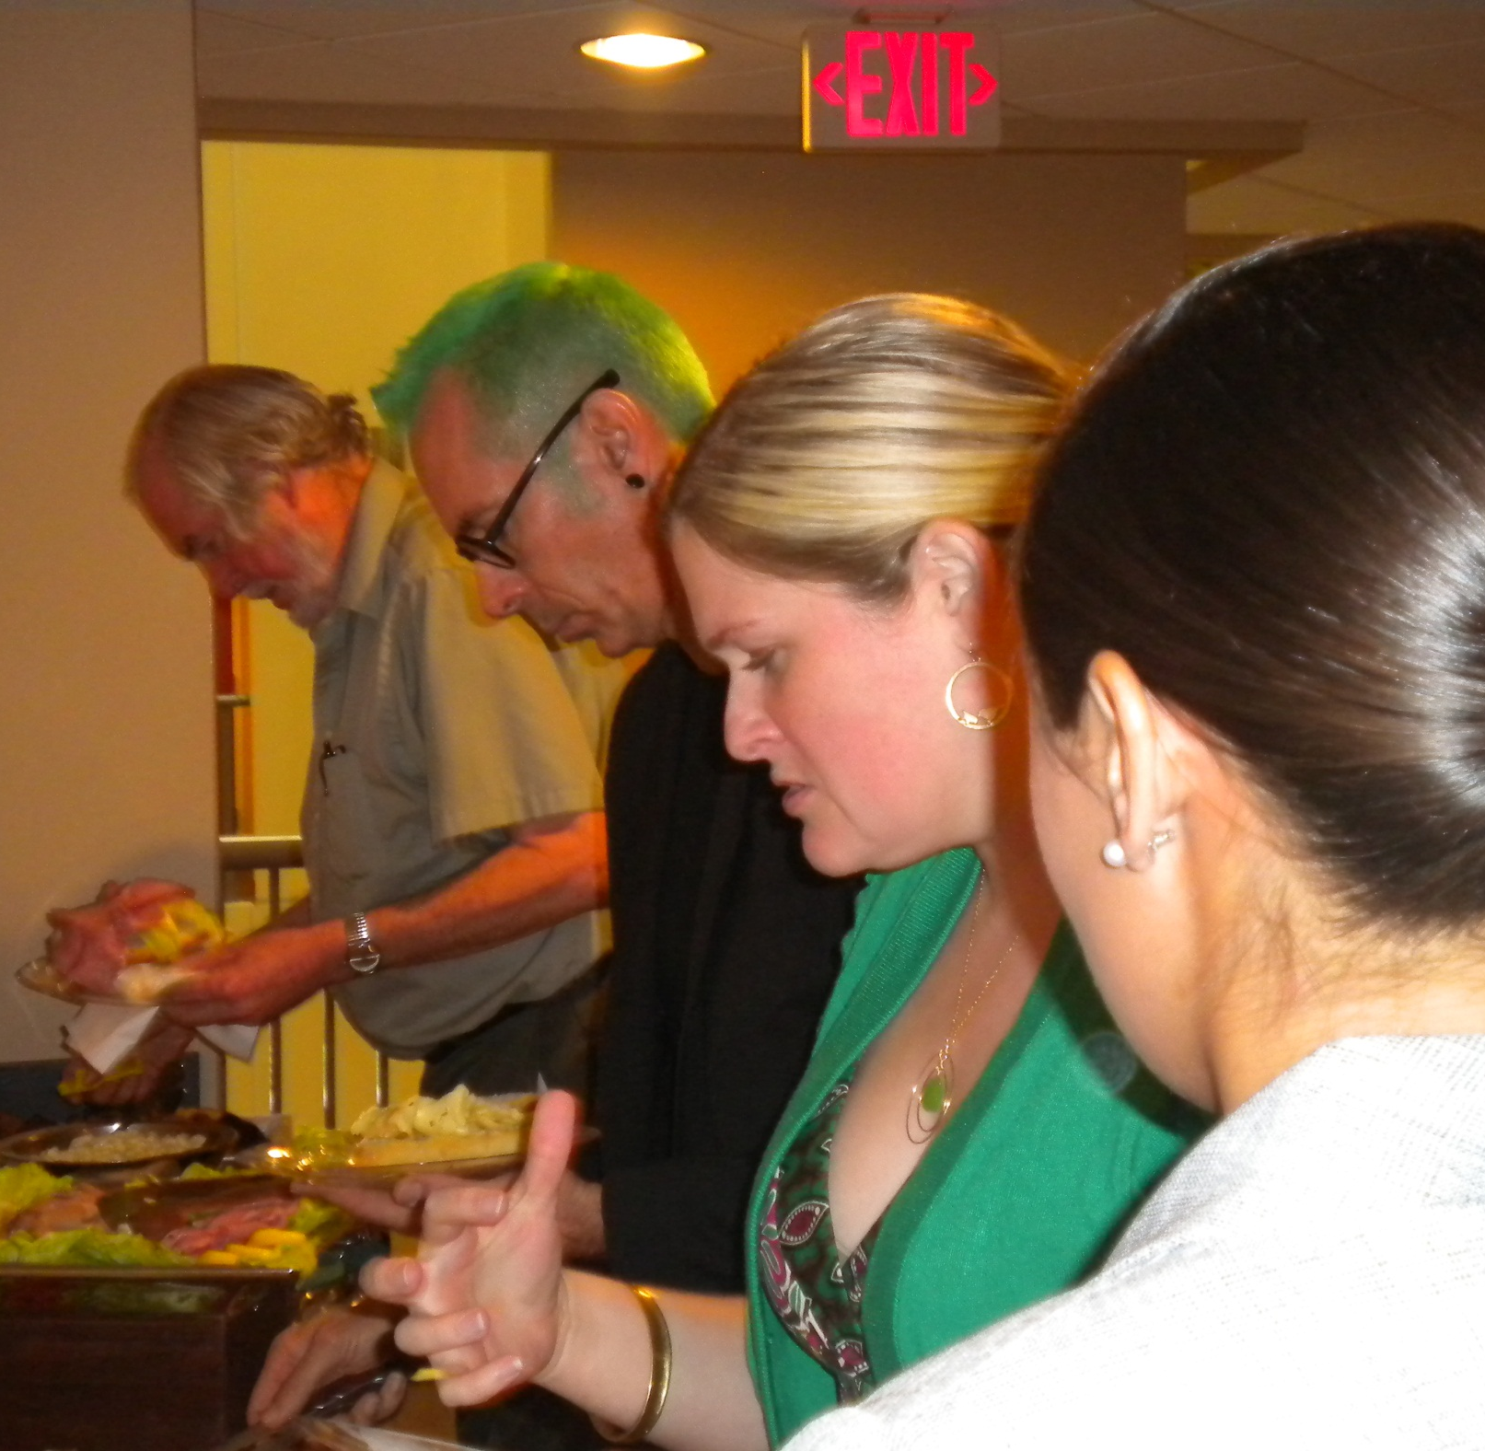
LUNCH WTH COLLEAGUES

Slide 17
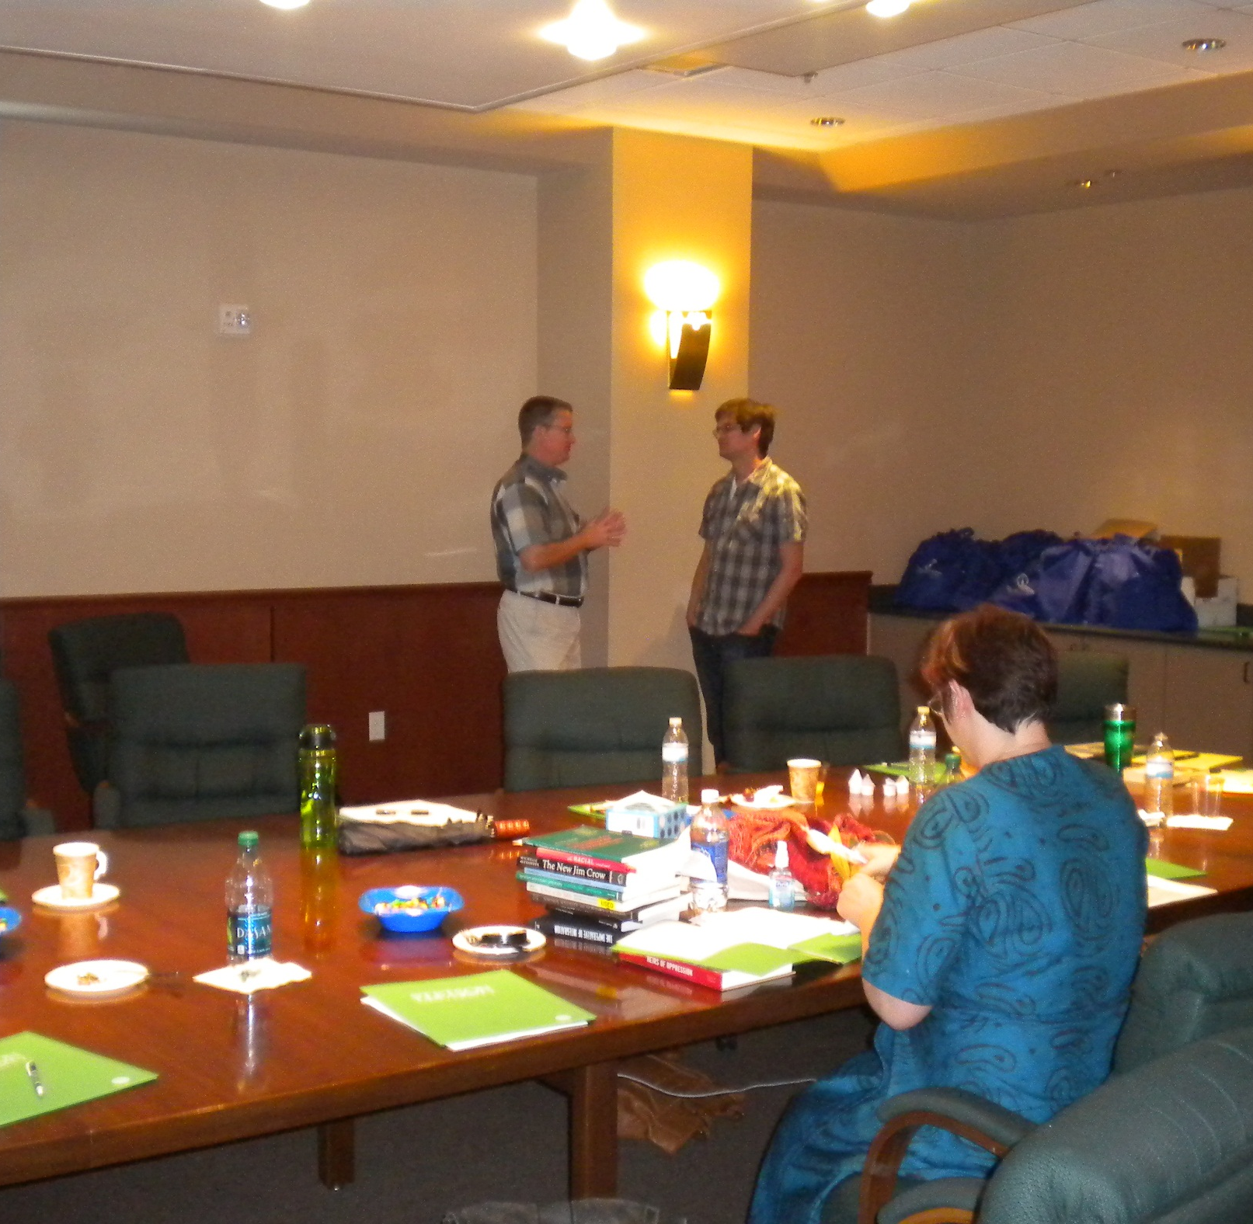
LUNCH TIME

Slide 18
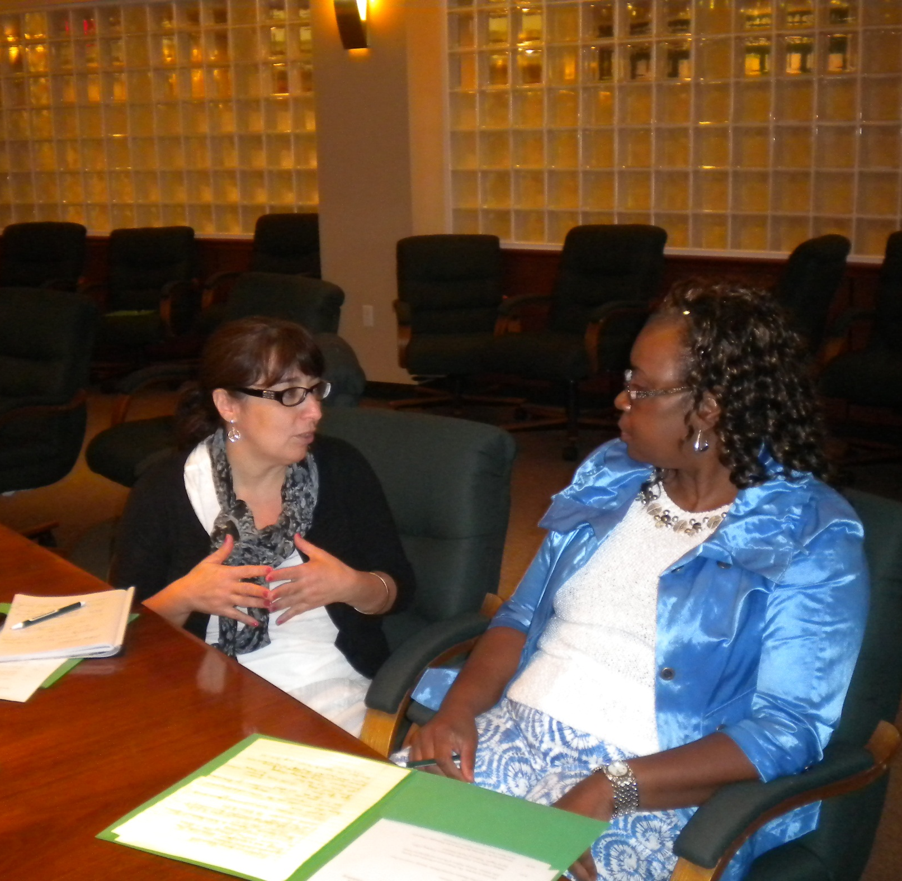
SOCIALIZING DURING A Break

Slide 19
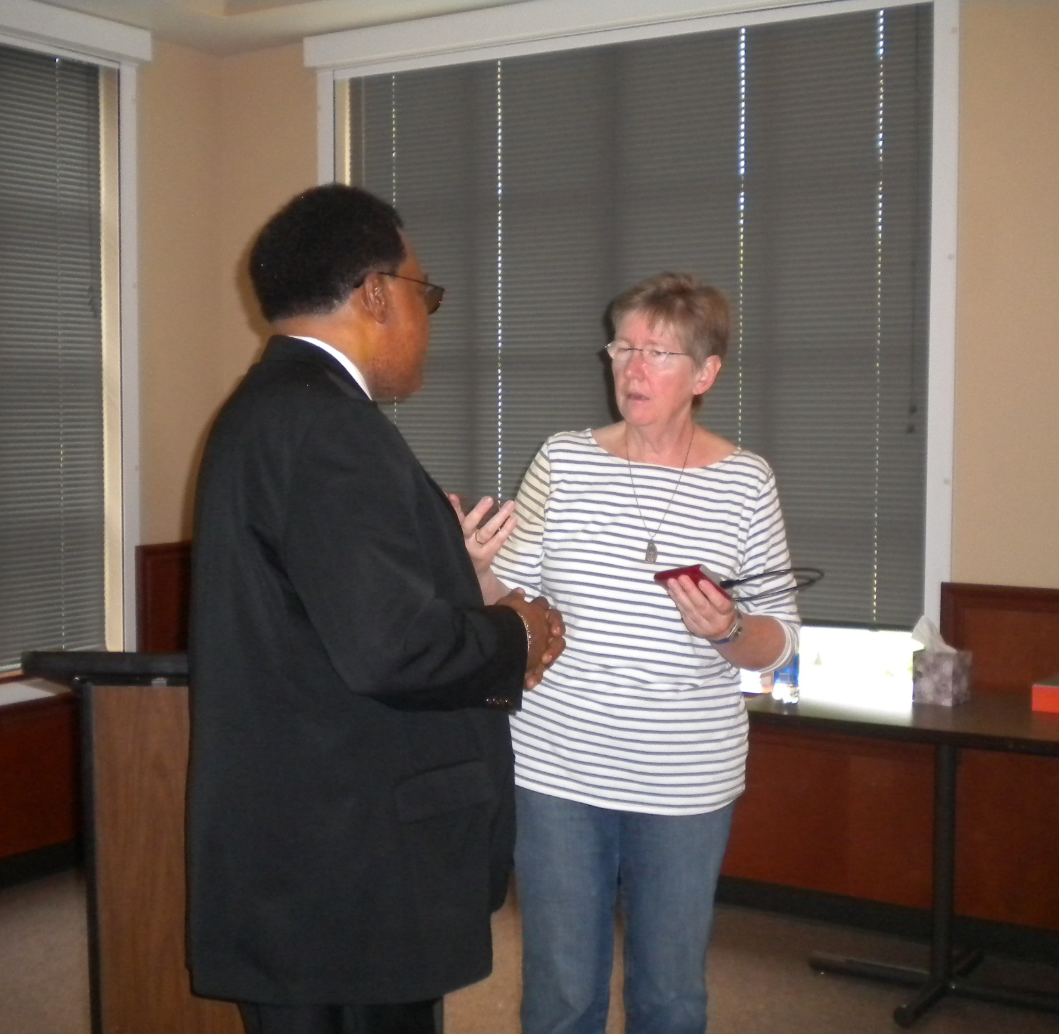
SOCIALIZING DURING A Break

Slide 20
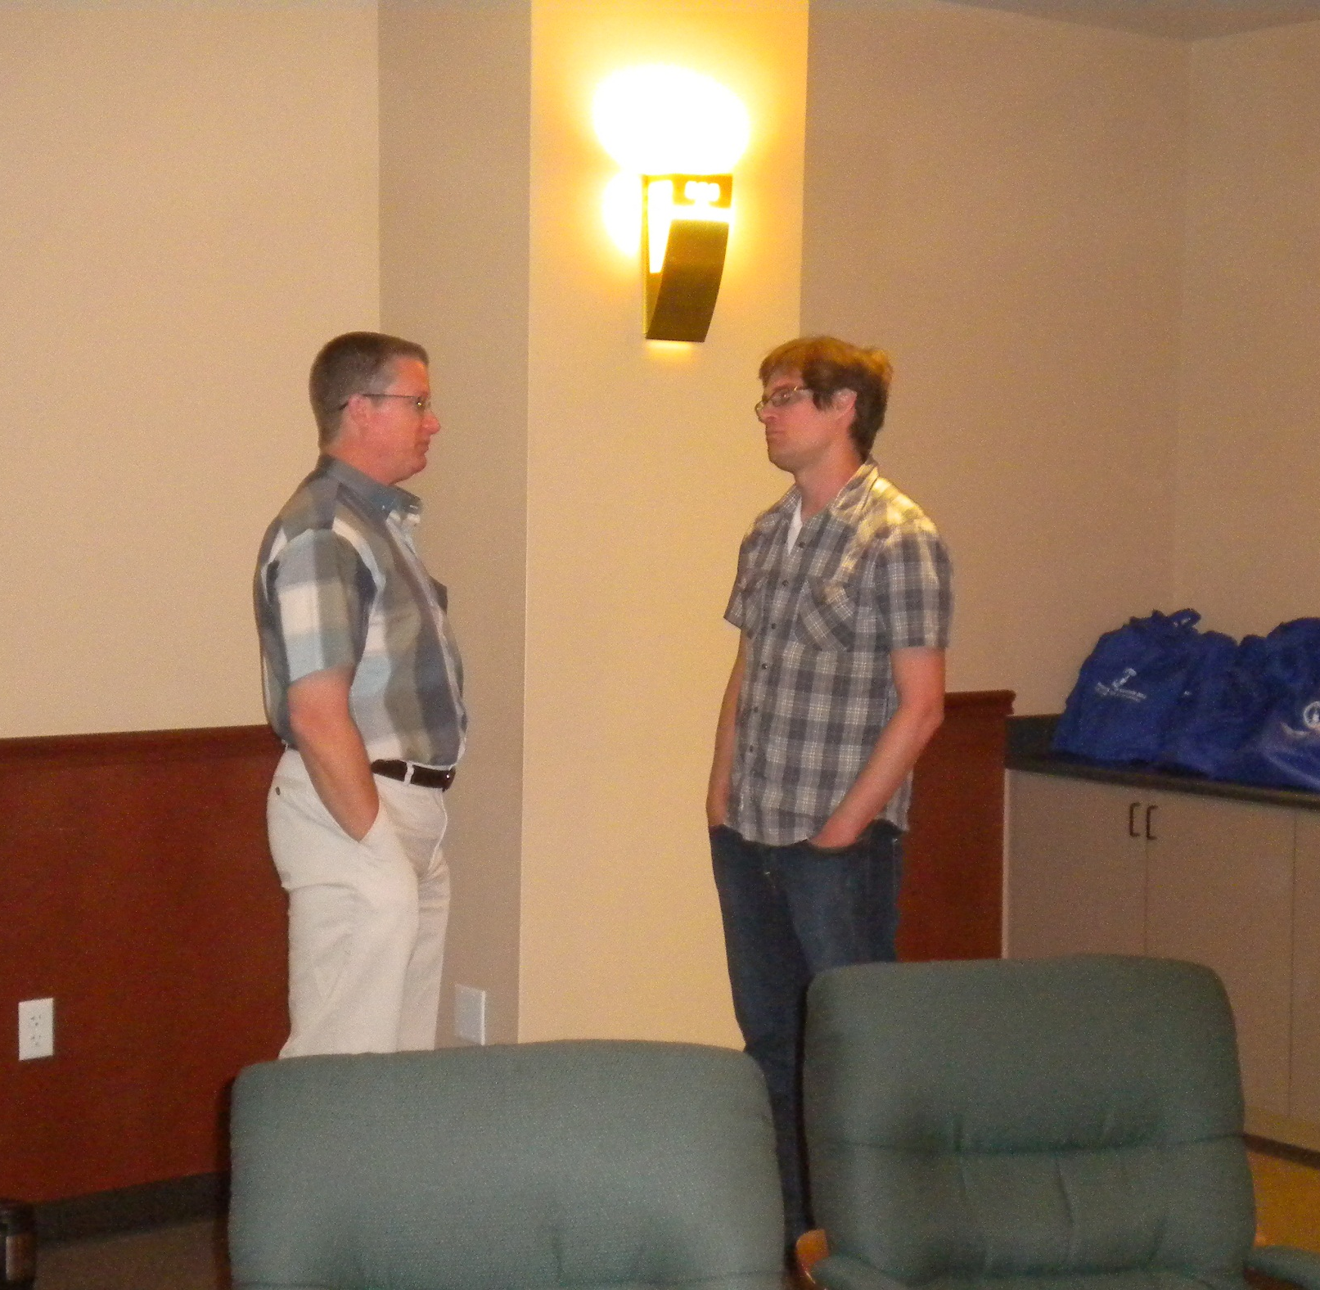
SOCIALIZING DURING A BREAK

